Slide 1
Exploring the effect of growth conditions on the volatile metabolome of Chromobacterium vaccinii and Chromobacterium violaceum
Diana Ramirez
Dr. Heather Bean Lab
Notes:
Hello, my name is Diana Ramirez and I am currently a senior studying Microbiology at Arizona State University. I work in Dr. Heather Bean’s lab and today I will be talking about my project which is Exploring the effect of growth conditions on the volatile metabolome of Chromobacterium vaccinii and Chromobacterium violaceum.

Slide 2
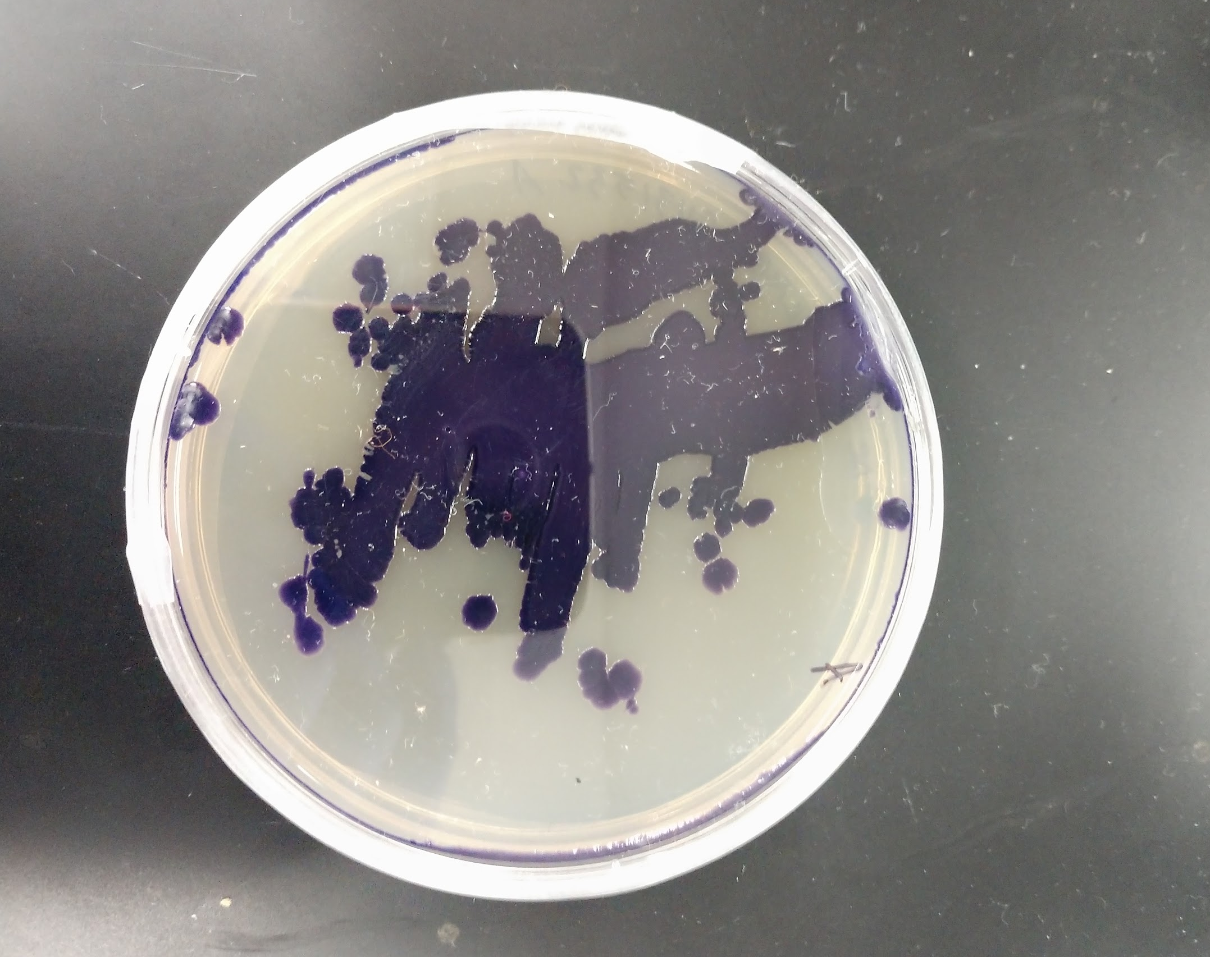
Chromobacterium spp.
Notes:
The two bacterial strains I mentioned belong to the Chromobacterium genus. Chromobacterium are violet pigmented bacteria that are commonly found in soil and water. These organisms are gram negative bacilli and produce violacein, a secondary metabolite seen as a violet pigment that acts as a chemical weapon against viruses, fungi, tumors, and bacteria. Of all these properties possessed by Chromobacterium strains, what I find most interesting is their ability to inhibit fungal growth.

Slide 3
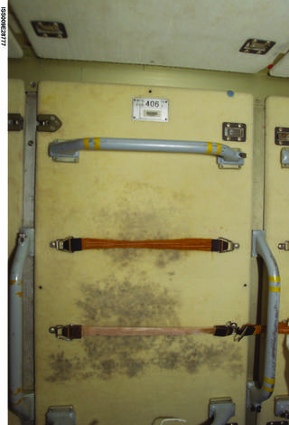
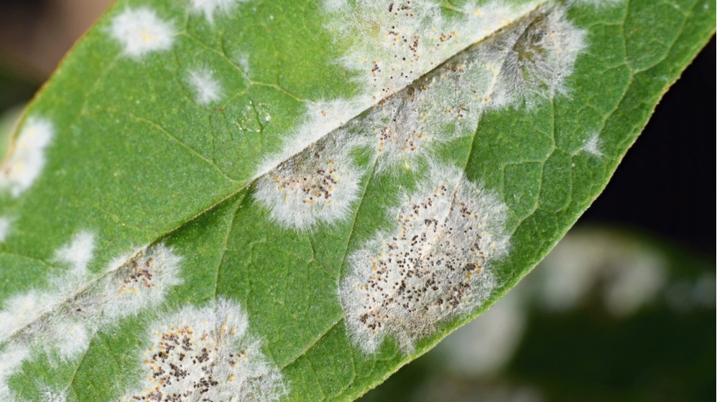
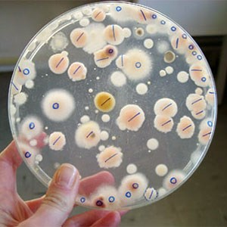
Fungi on the ISS grows on a panel of the Russian Zarya Module where exercise clothes were hung to dry.
Credits: NASA
Credits: The Swedish University of Agricultural Sciences
Credits: Shutterstock
Notes:
Fungi pose a huge threat, not only on earth but also in space. Here on the left we have a picture of the International Space Station. Mold is growing on a panel where exercise clothes was hung to dry. And on the right we have a picture of a leaf infected with fungi. In the middle is a petri-plate of many types of fungi. What we might be most familiar with human fungal pathogens, I will spare you from the images but common fungal diseases are tinea pedis, or athlete’s foot, ringworm, and Valley Fever. Fungi also infect plants. For example, controlling plant pathogenic fungi results in 65% of our crop loss which is equivalent to $21 billion spent a year trying to control fungal infestation in crops, and this is just in the United States.

Slide 4
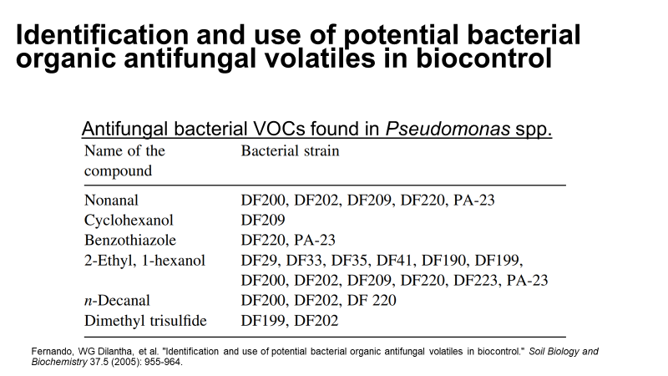
Notes:
Researchers are trying to mitigate plant pathogenic fungi using biocontrol. The first report on the identification and use of bacterial antifungal volatiles in biocontrol was published in 2005. This study used bacteria isolated from canola and soybean plants to inhibit the growth of Sclerotinia sclerotiorum, a white mold that is found in many vegetable crops. This report identified 6 volatile organic compounds produced by the bacteria that inhibit fungal growth.

Slide 5
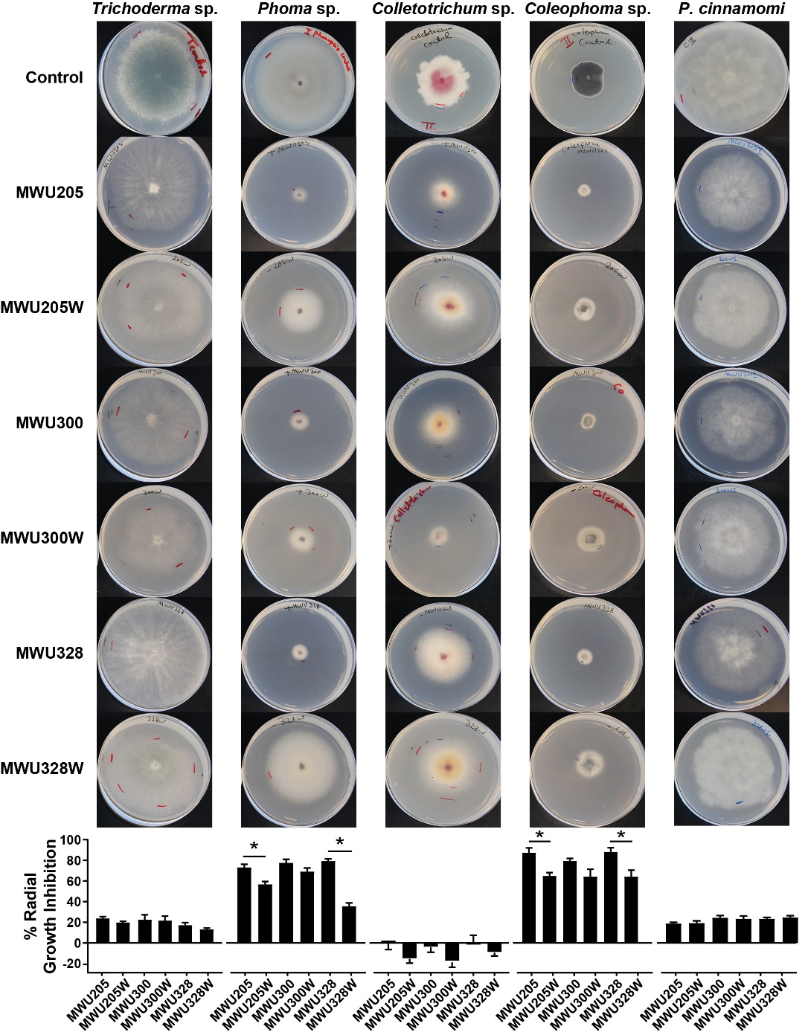
Effects of Chromobacterium VOCs on fungi
Bacterial isolates produce organic compounds that cause growth inhibition of oomycete and fungal plant pathogens
Ebadzadsahrai, Ghazal, Emily A. Higgins Keppler, Scott D. Soby, Heather D. Bean. (In Revision) Inhibition of fungal growth and induction of a novel volatilome in response to Chromobacterium vaccinii volatile organic compounds. Frontiers in Microbiology
Notes:
Current collaborative research between Arizona State University and Midwestern University studied the effect of Chromobacterium volatile organic compounds or VOCs on fungi. Research used Chromobacterium vaccinii, a bacteria isolated from cranberry bog soil and observed that their bacterial isolates produced organic compounds that caused growth inhibition of oomycete and fungal plant pathogens. This figure shows on the left the different Chromobacterium strains used in this study and across the top are the fungal and oomycetes that the bacteria was tested against, with the first row being the control so growth of fungi without bacterial volatile interaction. The rows below are the fungi cultured in the presence of C. vaccinii VOCS. The degree of inhibition is shown in the bottom with the taller bars indicating greater inhibition.

Slide 6
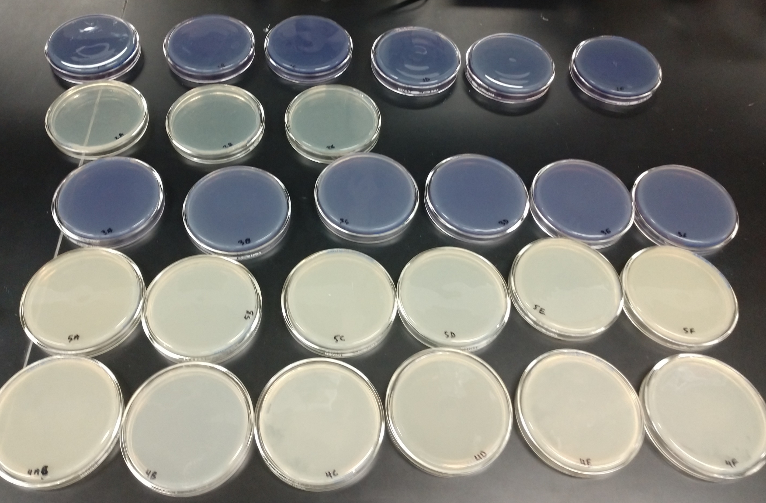
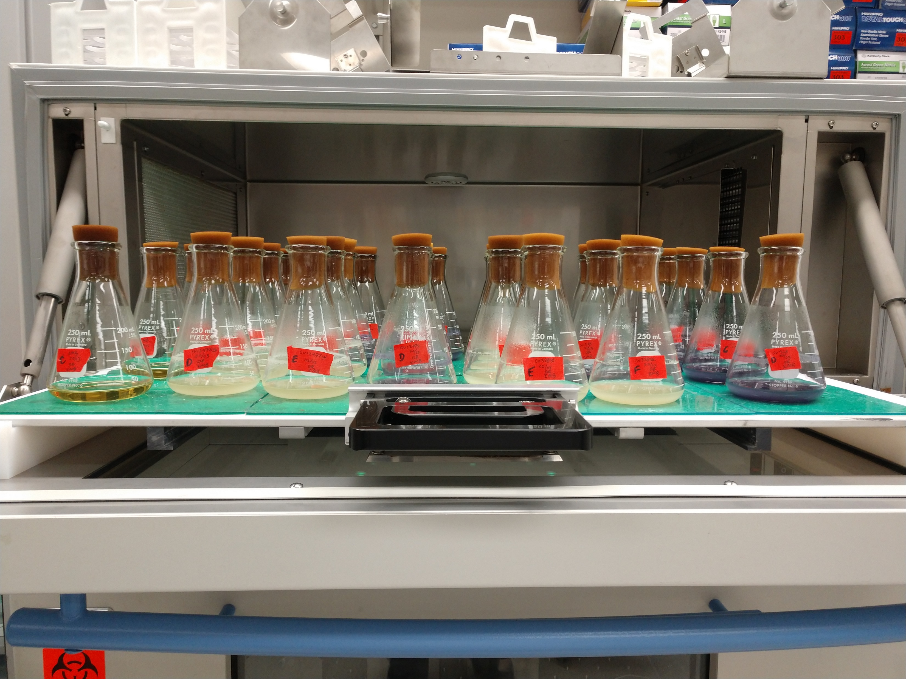
Are VOCs influenced by growth conditions?
Notes:
under what conditions are these VOCs being produced? Are volatile organic compounds influenced by growth conditions? My hypothesis is yes. To test this I began to grow Chromobacterium vaccinii, the bacteria used in the previous study, and Chromobacterium violaceum, the most commonly studied Chromobacterium strain.

Slide 7
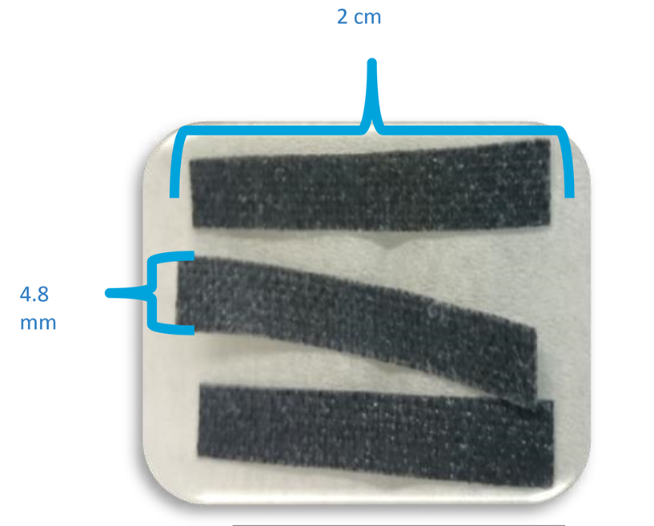
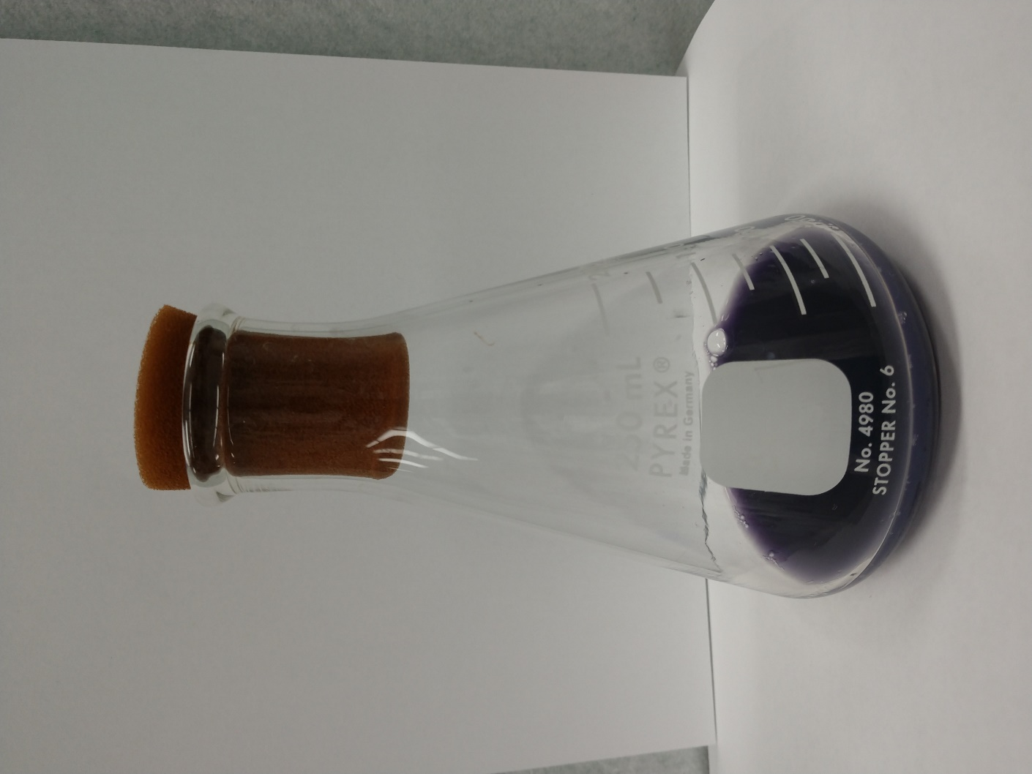
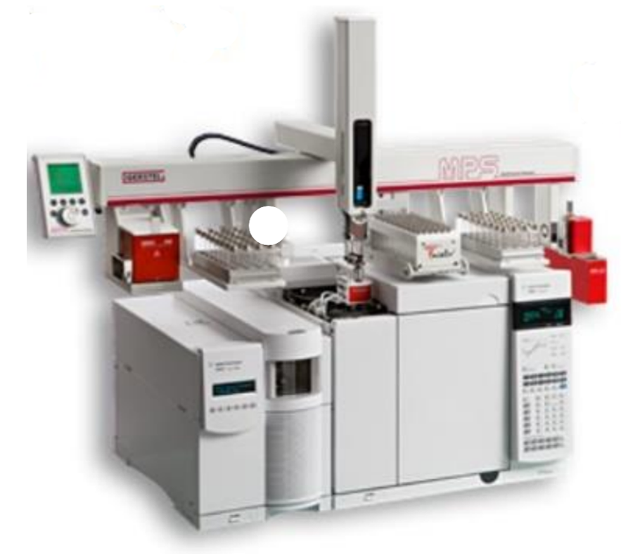
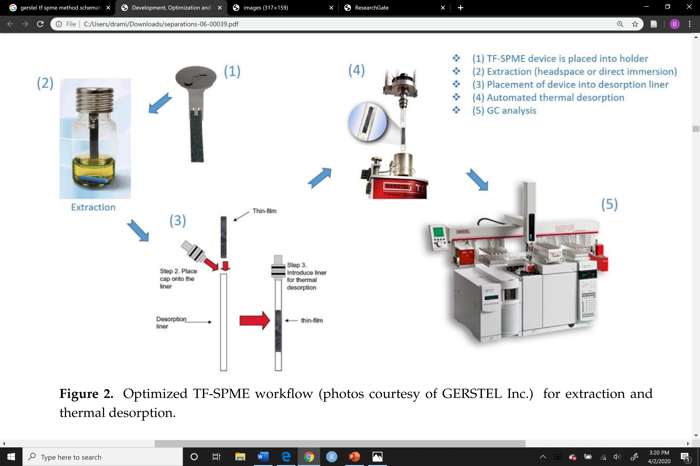
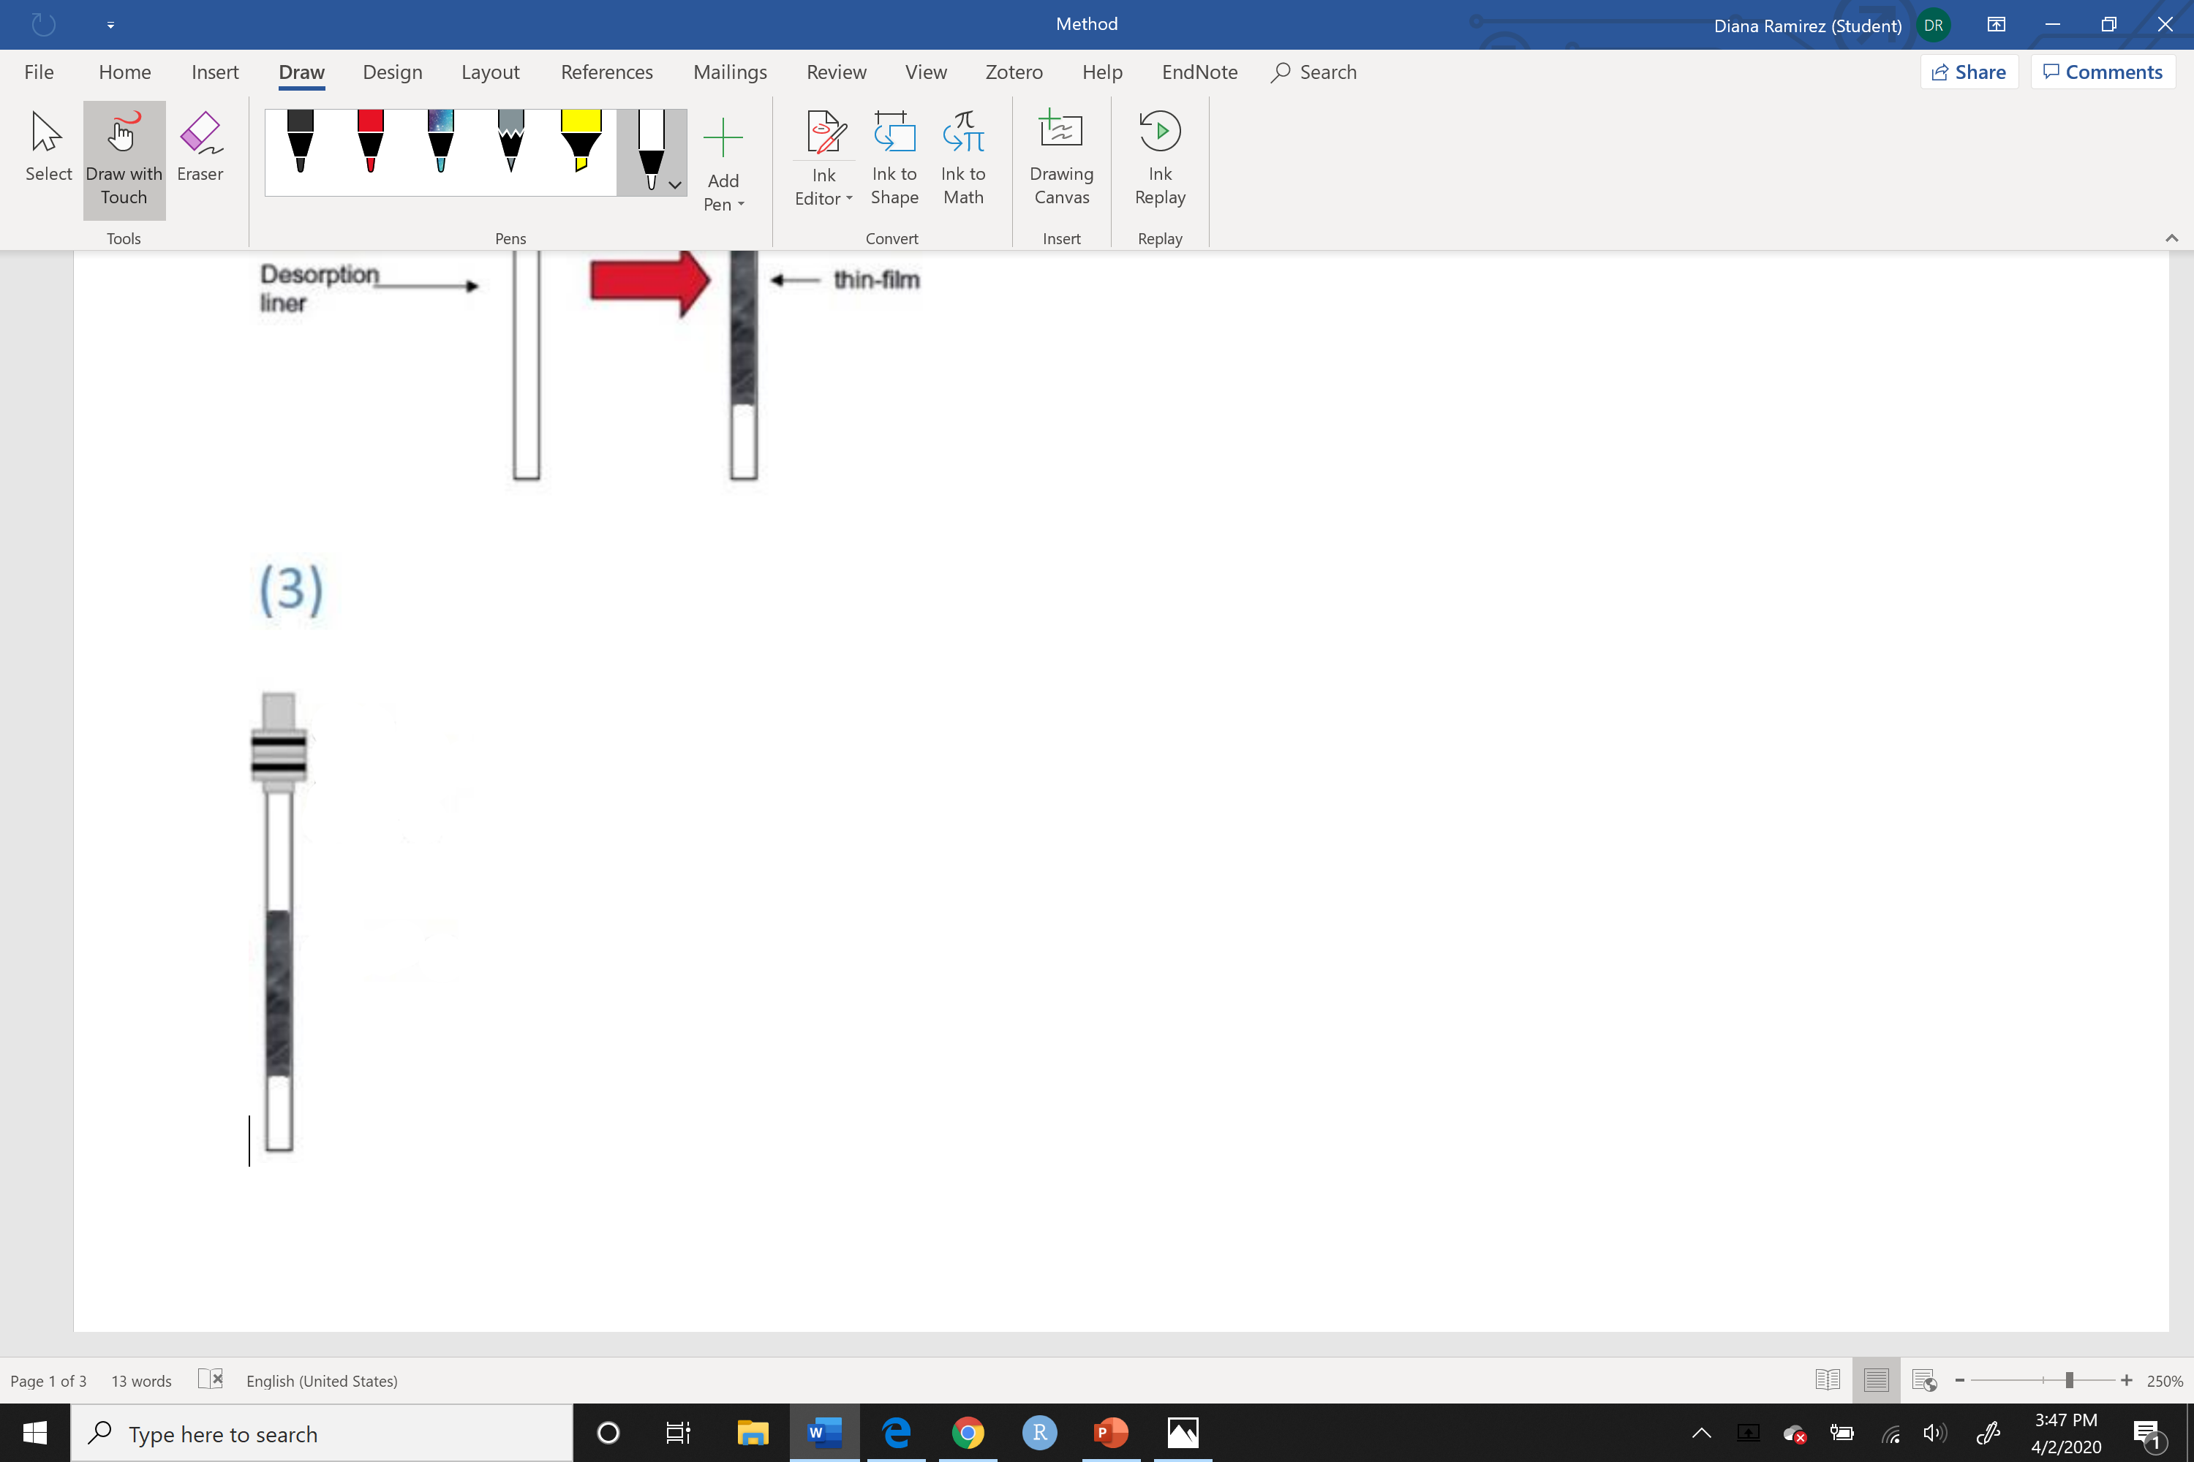
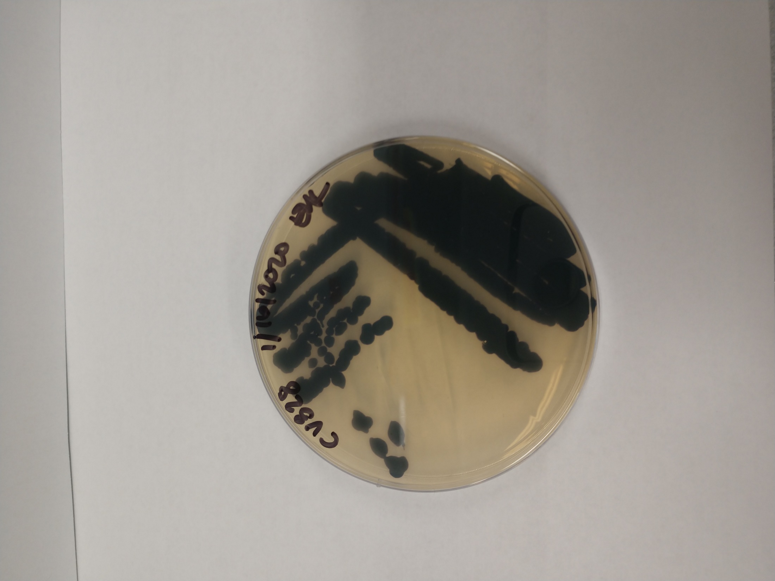
Methods
Optimized TF-SPME workflow (photos courtesy of GERSTEL Inc. with modified images) for extraction and thermal desorption.
Notes:
I cultured these strains in liquid and semi-solid media for equal amounts of time and then placed Thin Films in the bacterial culture and collected volatiles for an hour. To collect their volatiles, I used thin films which are these small polymer devices that absorb volatiles out of the atmosphere.

Slide 8
Methods
Optimized TF-SPME workflow (photos courtesy of GERSTEL Inc. with modified images) for extraction and thermal desorption.
Notes:
I cultured these strains in liquid and semi-solid media for equal amounts of time and then placed Thin Films in the bacterial culture and collected volatiles for an hour. To collect their volatiles, I used thin films which are these small polymer devices that absorb volatiles out of the atmosphere.

Slide 9
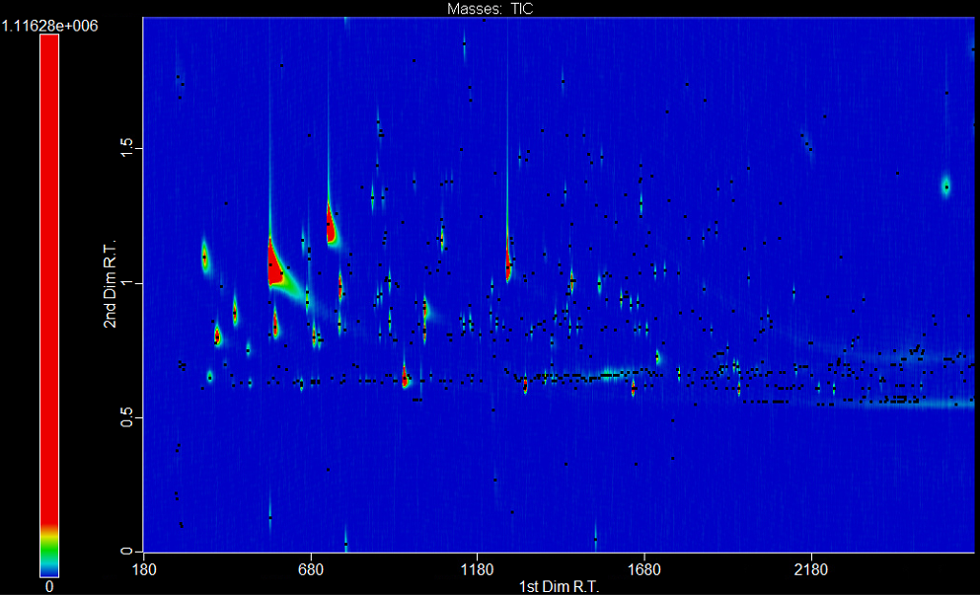
CV328 Liquid Culture
Notes:
This is a chromatogram of C. vaccinii, the different peaks indicate different compounds and the bigger a peak is the more abundant it was found in the sample.

Slide 10
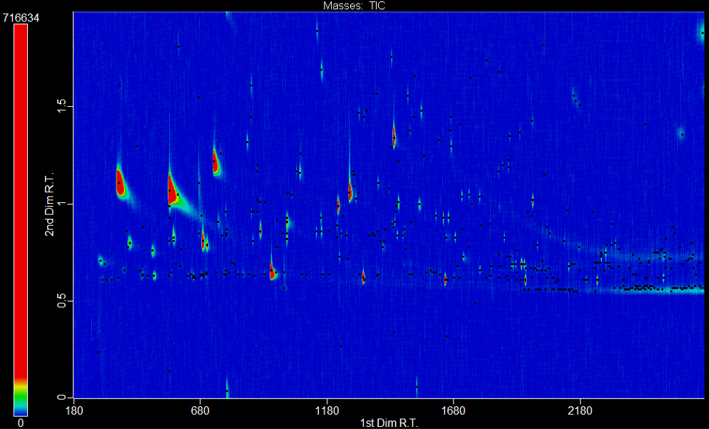
CV328 liquid culture CV328 semi-solid culture
Notes:
This is how it compares to the C. vaccinii cultured in semi solid media.
If we focus on these three peaks in the liquid culture and compare them to the three peaks in the semi-solid culture we can see that they are different in size and abundance.

Slide 11
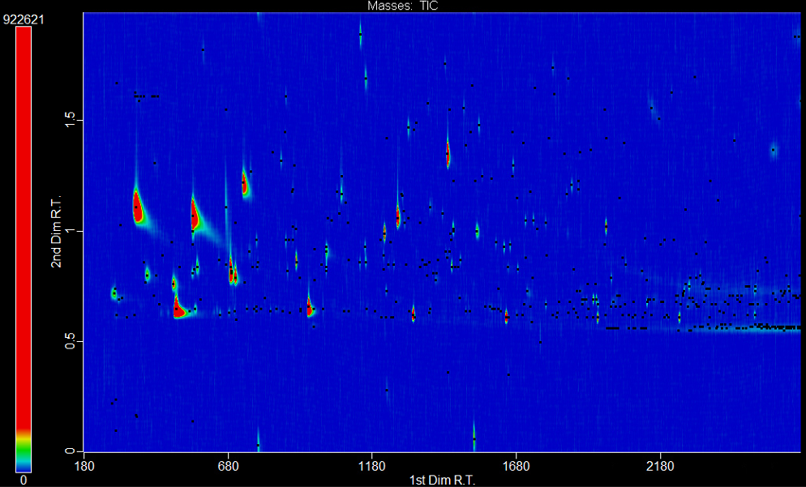
CV328 semi- solid culture CV328 liquid culture
KMB semi-solid culture KMB liquid culture
Notes:
And this is how they compare to the pure liquid and semi-solid media we used to culture the bacteria.

Slide 12
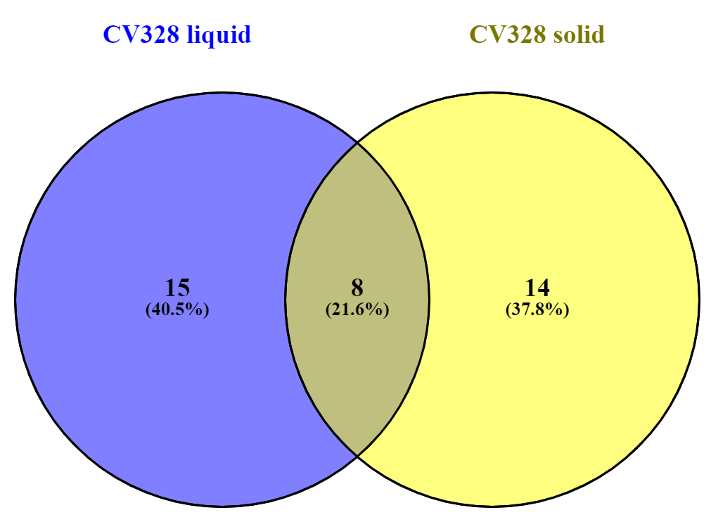
C. vaccinii solid vs. liquid
Notes:
To better understand the differences in the peaks produced in the different growth conditions I created this venn diagram. It agrees with the hypothesis that there are differences in volatile metabolite production in different growth conditions.

Slide 13
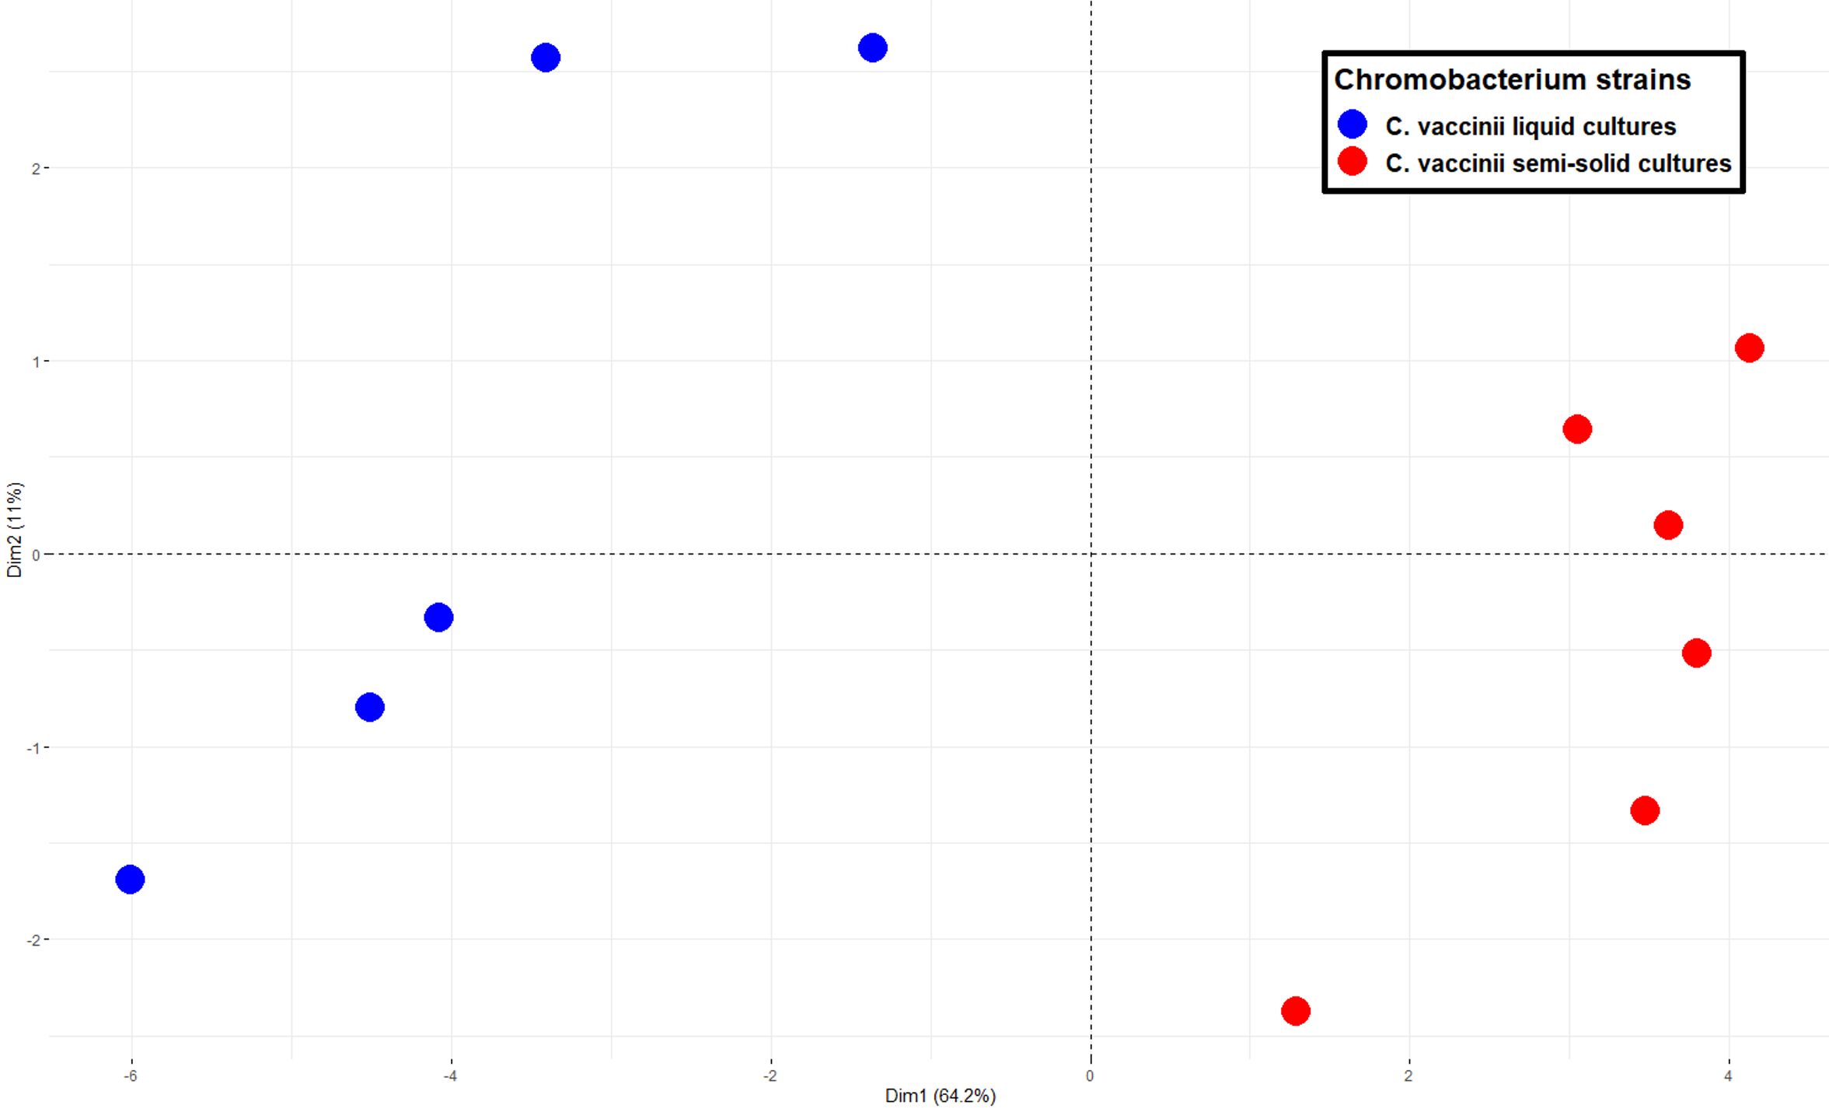
C. vaccinii liquid vs. solid
Notes:
Using this Principle component analysis, we see that the biological samples of liquid cultures of c. vaccinii shown in blue separated from the petri plate cultures of c. vaccinii that are shown in red.

Slide 14
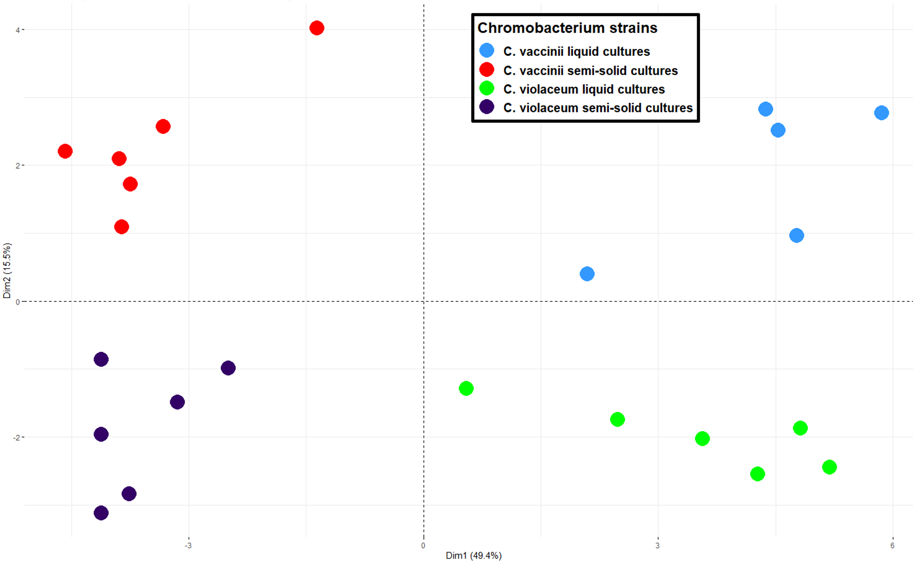
C. vaccinii liquid vs. C. vaccinii solid vs. C. violaceum liquid vs. C. violaceum solid
Notes:
Even more interesting, when comparing all samples, c. vaccinii liquid culture in blue, c. vaccinii semi-solid culture in red, C. violaceum liquid culture in green, and c. violaceum semisolid culture in purple, the samples separated based on their growth conditions instead of their biology.

Slide 15
Future Directions
Compare data to findings from Midwestern University
Identify the role quorum sensing has on volatile production in liquid and semi-solid media
Notes:
Moving forward, we are interested in comparing to see if any antifungal volatiles detected by ASU and Midwestern University are produced differently in liquid and semi solid media.
Additionally, we aim to identify the role quorum sensing has on volatile production in liquid and semi-solid media.

Slide 16
Acknowledgements
Dr. Heather Bean
BEAN Lab
Midwestern University
National Science Foundation LEAP Program
School of Life Sciences Undergraduate Research Program
ASU/NASA Space Grant Program

